Slide 1



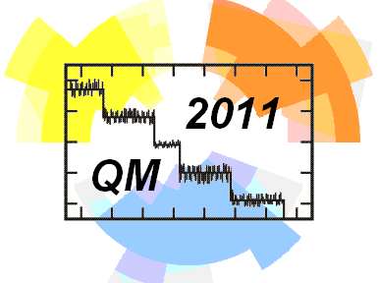
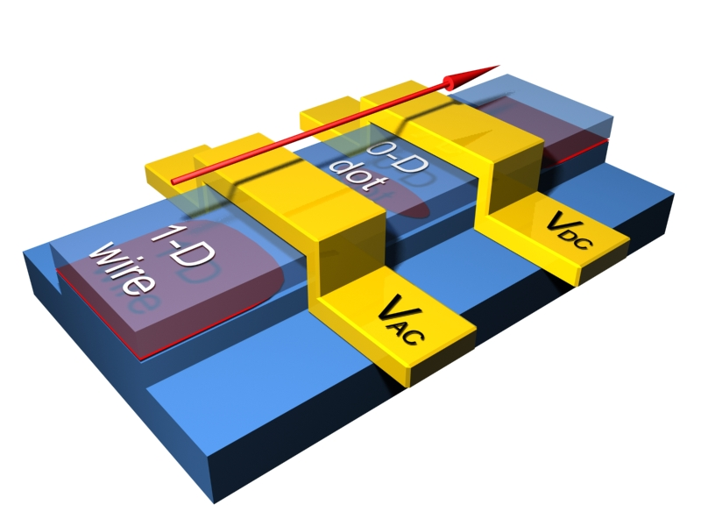
Single-gate non-adiabatic quantized charge pumps
Datorzinātnes lietojumi un tās saiknes ar kvantu fiziku
Vyacheslavs (Slava) Kashcheyevs
University of Latvia, Riga, Latvia
Collaboration:
Bernd Kästner
PTB, Braunschweig, Germany
International Conference on Quantum Metrology,
Poznań, Poland, May 13th , 2011

Slide 2
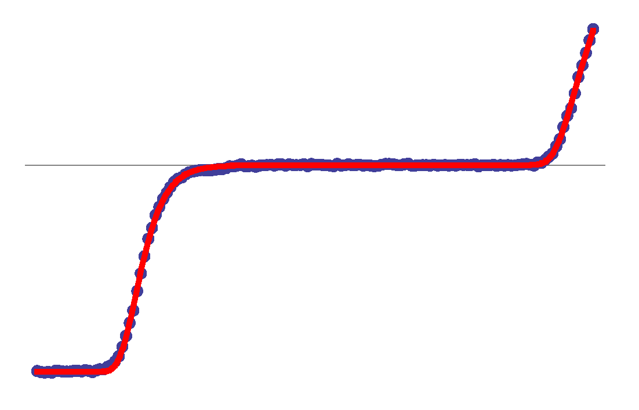
Single-gate pumps in metrology context
A particular class of “quantized pumps”
Aim at low, predictable error rate
Motivated by…
  metrology needs
  basic physics
I = e f
I
1 e per cycle
V₂

Slide 3
Outline
Introduction (phenomenological)
Message I: constructive non-adiabaticity
Message II: universality of decay cascade
Outlook for metrological applications

Slide 4
Outline
Introduction (phenomenological)
Message I: constructive non-adiabaticity
Message II: universality of decay cascade
Outlook for metrological applications

Slide 5
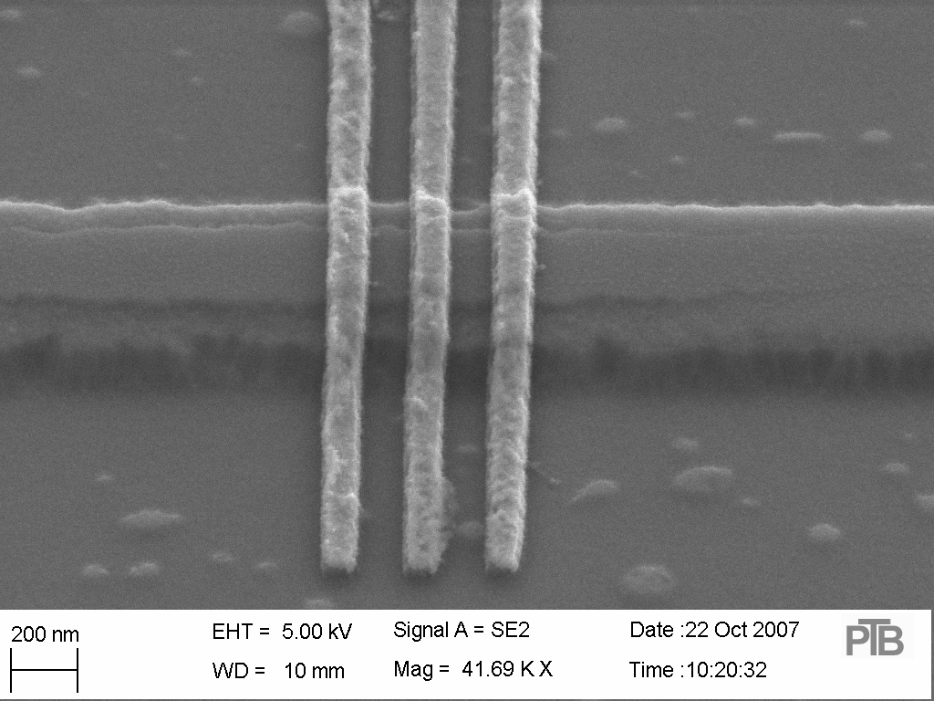
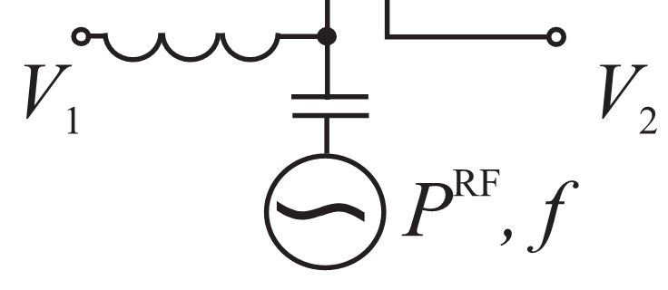
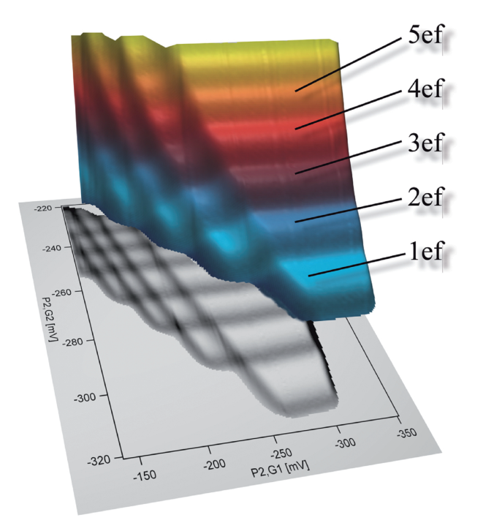
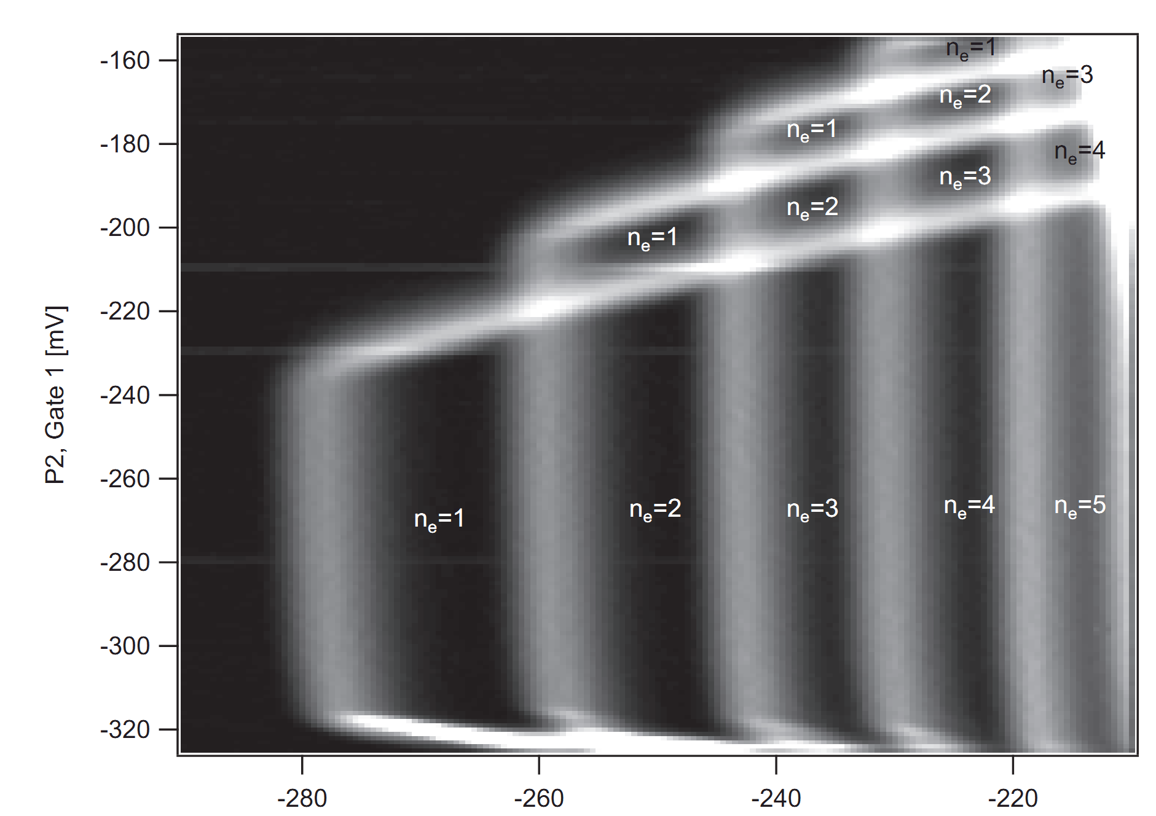
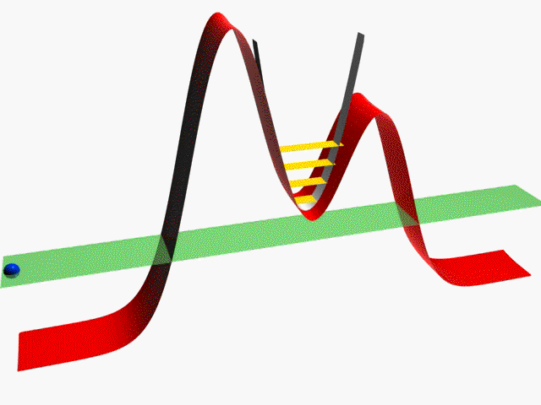
V₁(t) = V₁^{DC} + V₁^{AC} cos ωt
~ 250 nm
V₂
V₁(t)
V₁^{DC}
mV
f
V₁^{AC}
V₂
Quantum dot
Quantum dot
Animation: A. Müller
mV
Data: F. Luckas (U.of Hannover)
Notes:
Several type, we think of tunable. Colomb blockade, SET

Slide 6
Outline
Introduction (phenomenological)
Message I: constructive non-adiabaticity
Message II: universality of decay cascade
Outlook for metrological applications

Slide 7
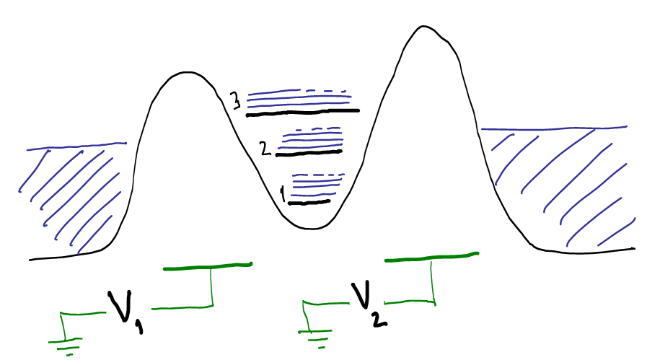
Double-barrier quantum dot
~ 250 nm
Quantum
dot
Source
Drain
Current I
V₂
V₁
Notes:
Several type, we think of tunable. Colomb blockade, SET

Slide 8
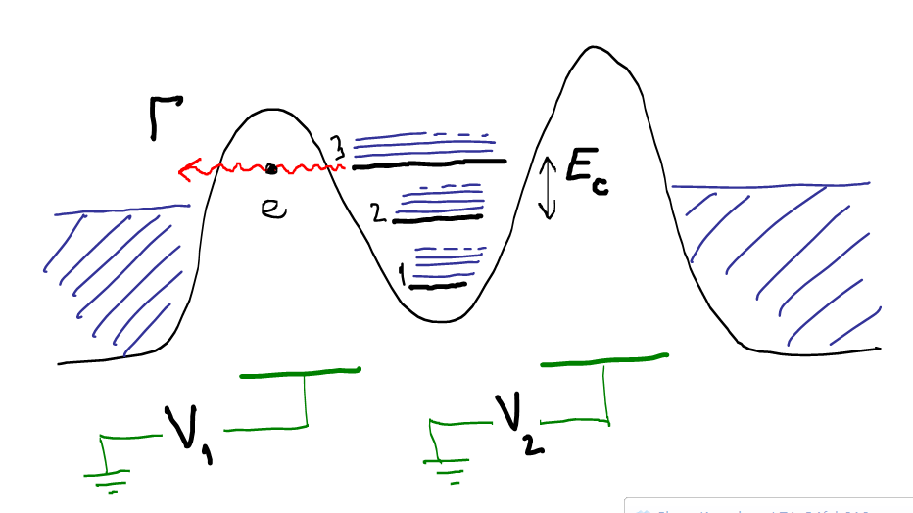
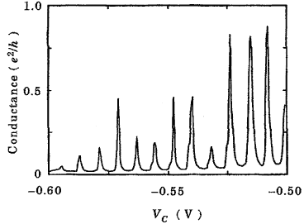



Charge stability diagram
Left
Bottom
energy
V₁
3
Right
2
1
0
V₂
Coulomb blockade
for
Resonance lines

Slide 9
Adiabatic paradigm for pumps
Left
Bottom
energy
Stay close to equilibrium
Well-established
SET technology
At least two
phase-shifted parameters
Increasing frequency increases error rate
V₁
3
Right
LOAD
2
1
0
UNLOAD
V₂
First quantized pump: Pothier et al, Eur.Phys.Lett., 17, 249 (1992)
“Electron counting capacitance standard”, Keller et al, Science 285, 1706 (1999)
Mapping of charge carrier type: Buitelaar, VK et al, Phys. Rev. Lett. 101, 126803 (2008)

Slide 10
Adiabatic vs single-gate pumping
Left
Bottom
energy
V₁
V₁
LOAD
Right
LOAD
1
1
0
UNLOAD
UNLOAD
0
V₂
V₂
Moskalets-Büttiker (2002) “no-go theorem” :
adiabatic single-parameter modulation cannot produce current
Blumenthal et al, Nature Physics 3, 343 (2007)
Kaestner, VK et al, Phys. Rev. B 77, 153301 (2008)

Slide 11
Outline
Introduction (phenomenological)
Message I: constructive non-adiabaticity
Message II: universality of decay cascade
Outlook for metrological applications

Slide 12
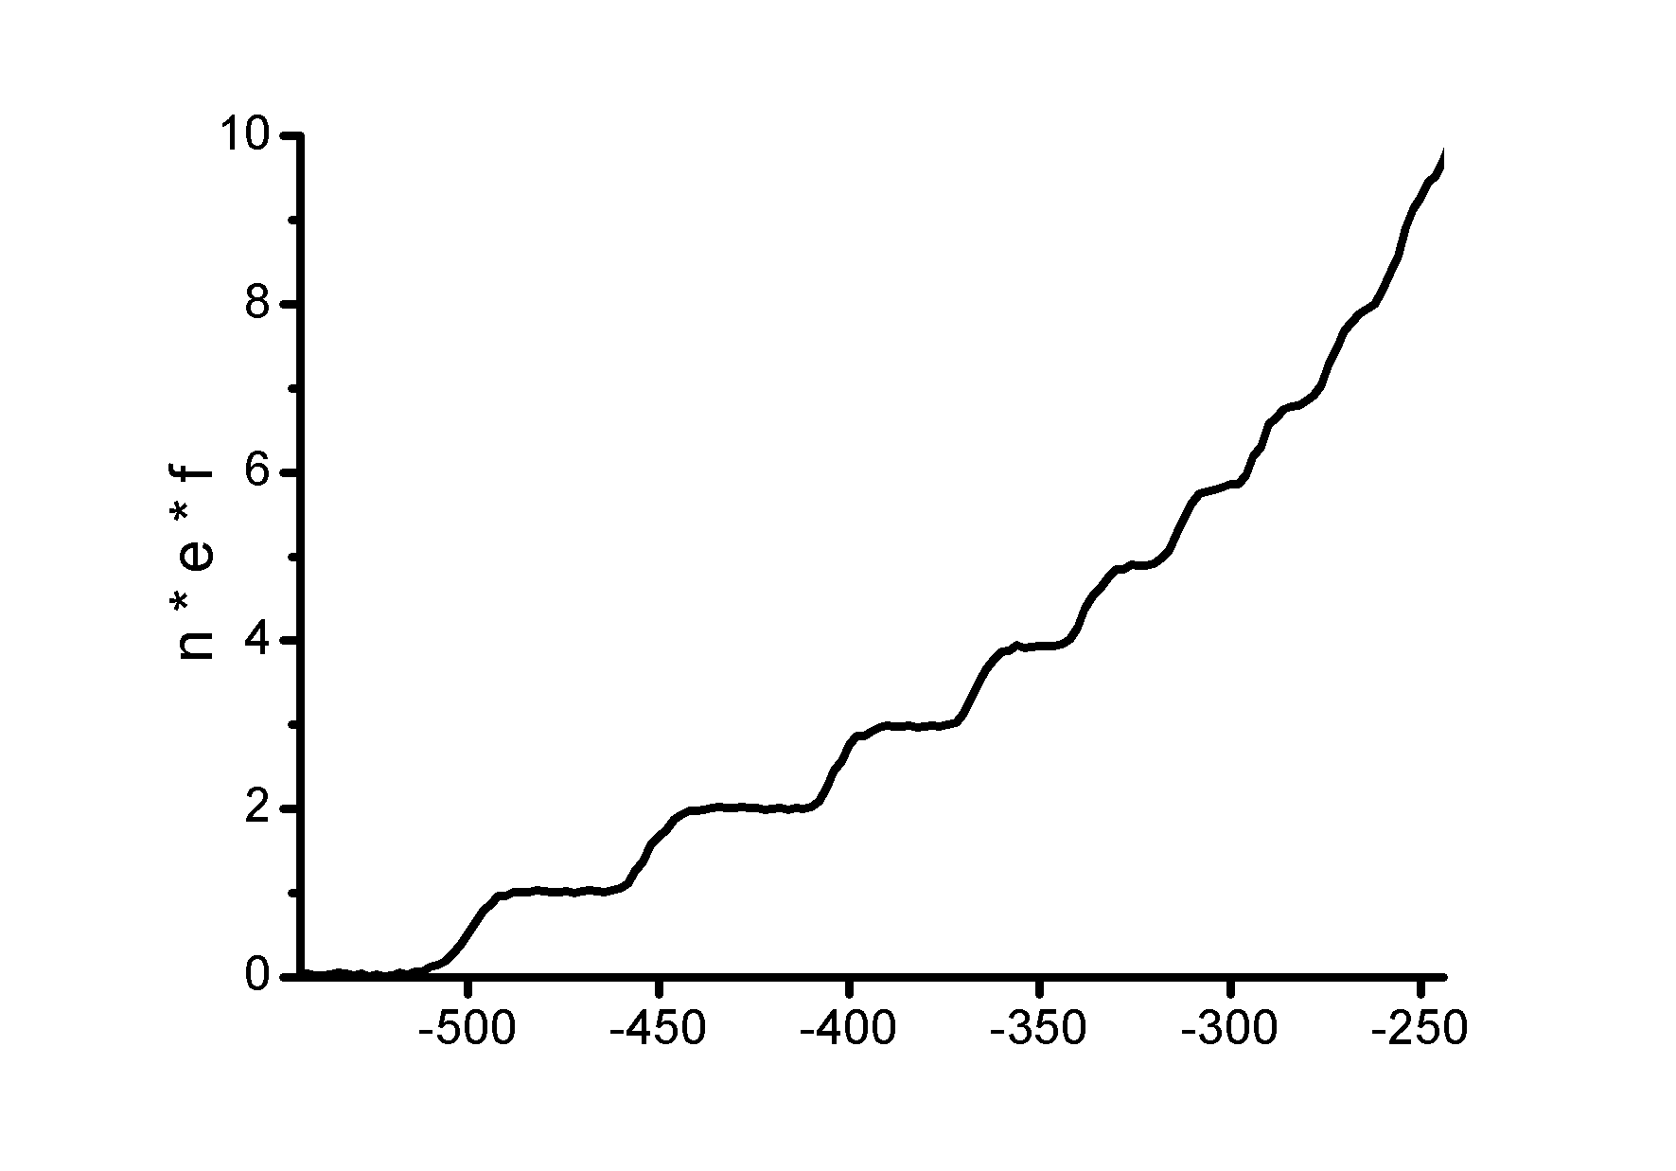
Universal limit: decay cascade regime
Current (e·f)
V (mV)
V
VK and B.Kaestner, Phys. Rev. Lett. 104, 186805 (2010)

Slide 13
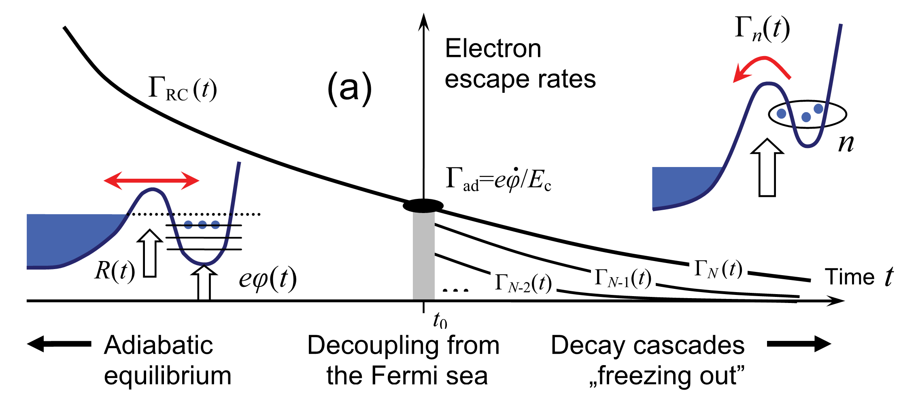
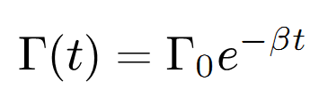




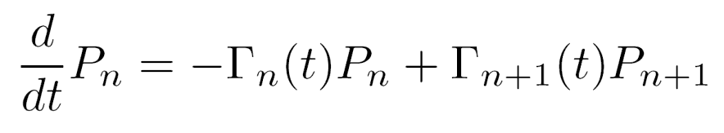
decreasing escape rate
escape rate to maintain equilibrium
essential non-equilibrium for
If then the initial condition is forgotten!
Raise faster
than decouple!
Happy families are all alike; every unhappy family is unhappy in its own way.
Leo Tolstoy, Anna Karenina, Chapter 1, first line

Slide 14
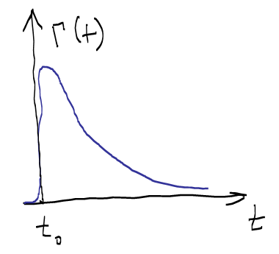
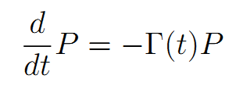
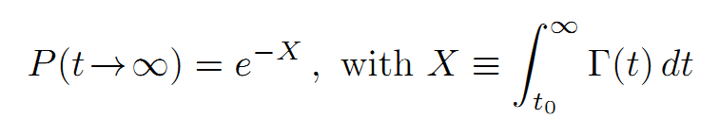
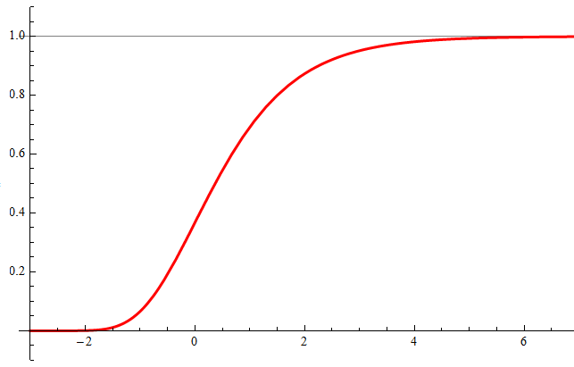

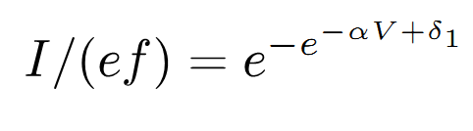
1-step line shape
Γ(t)
n
Backtunneling
to empty space
Survival probability:
Escape rate ansatz:
Fujiwara et al. Appl.Phys.Lett. 92, 042102 (2008)
Kaestner et al,Appl. Phys. Lett. 94, 012106 (2009)

Slide 15
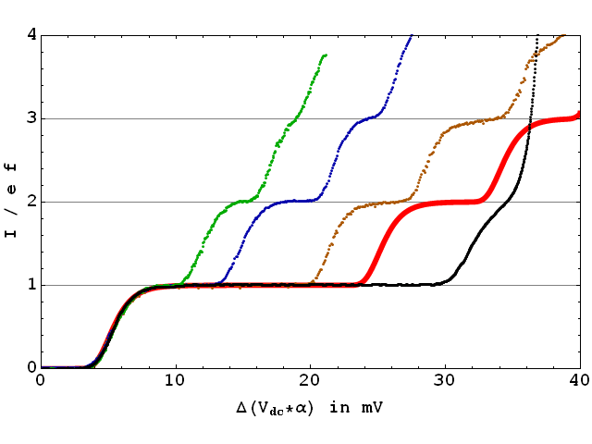
Universal shape in rescaled coordinates
Data: PTB group,
unpublished
Rescaled voltage

Slide 16
Single-step fitting
Plot on double-log scale
Look for straight line
I=ef=8 pA
f=50 MHz
T=40 mK
Data from B.Kaestner et al,
Appl. Phys. Lett. 94, 012106 (2009)

Slide 17
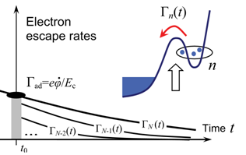
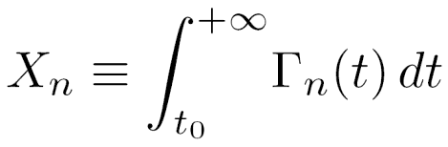


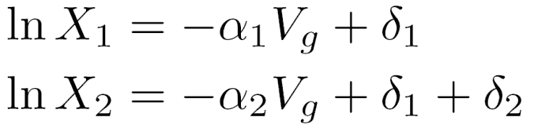
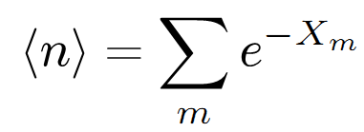
Many-step line shape
Define (dimensionless):
If there is scale separation…
…then the solution is

Slide 18
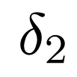

Two-step fitting
δ₂ is the figure of merit
I=ef=8 pA
f=50 MHz
T=40 mK
Fitting parameters!
Data from B.Kaestner et al,Appl. Phys. Lett. 94, 012106 (2009)

Slide 19
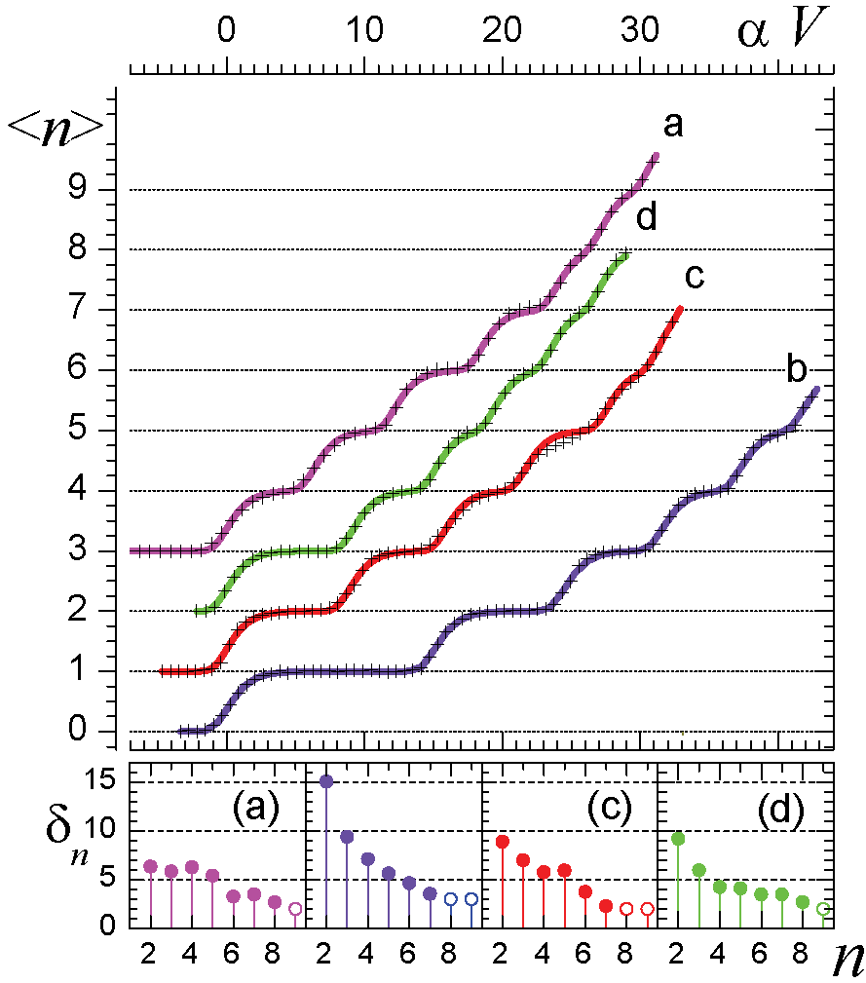
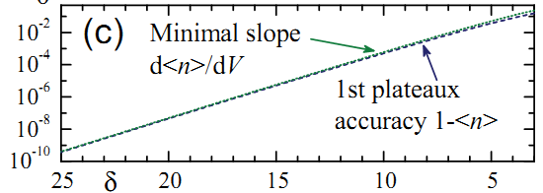
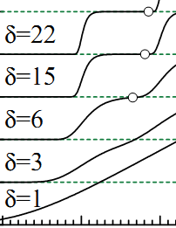
Universality of the decay cascade
δ₂ is the figure of merit
Si nanowire dots, pulsed , T=20K
Fujiwara et al. APL (2008)
GaAs/AlGaAs etched, B=3 T
Kaestner et al APL (2009)
Surface-acoustic-wave-driven
Janssen & Hartland (2001)
Classical simulation,
Robinson & Barnes,
PRB (2001)
δ₅
δ₄
δ₃
Theory
prediction:
δ₂
Device
“fingerprint”
αV/ δ
VK and B.Kaestner, arXiv (2009); PRL (2010)

Slide 20
Outline
Introduction (phenomenological)
Message I: constructive non-adiabaticity
Message II: universality of decay cascade
Outlook for metrological applications

Slide 21
Traceable measurement (NPL)
δ₂=15.2 (Fit A1)
δ₂=17.1 (Fit A2)
f=340 MHz
S.Giblin et al., New J. Phys. 12 073013 (2010)

Slide 22
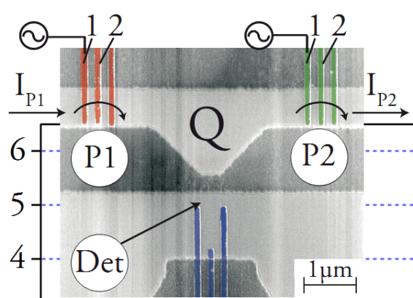
Outlook for metrological applications
Advantages:
  Optimal frequencies in 100 MHz ÷ 1 GHz range
  Stability against voltage bias ⇒ negligible leakage
  Single ac driving signal ⇒ parallelization
  Robustness ⇒ one gate per pump to tune
Optimization directions:
  barrier selectivity optimization
  serial operation with
  error detection and correction
  (Wulf & Zorin, arXiv:0811.3927)
L.Fricke et al., PRB (2011)

Slide 23
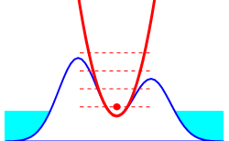
Thank you!

